Slide 1

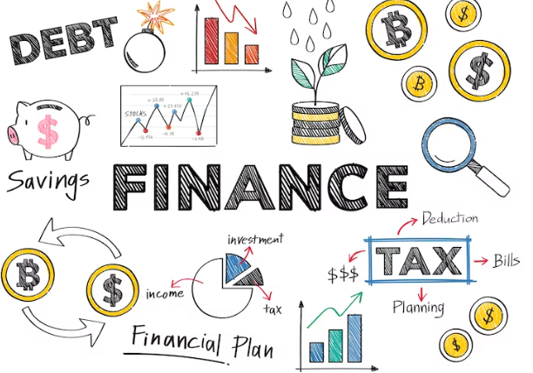
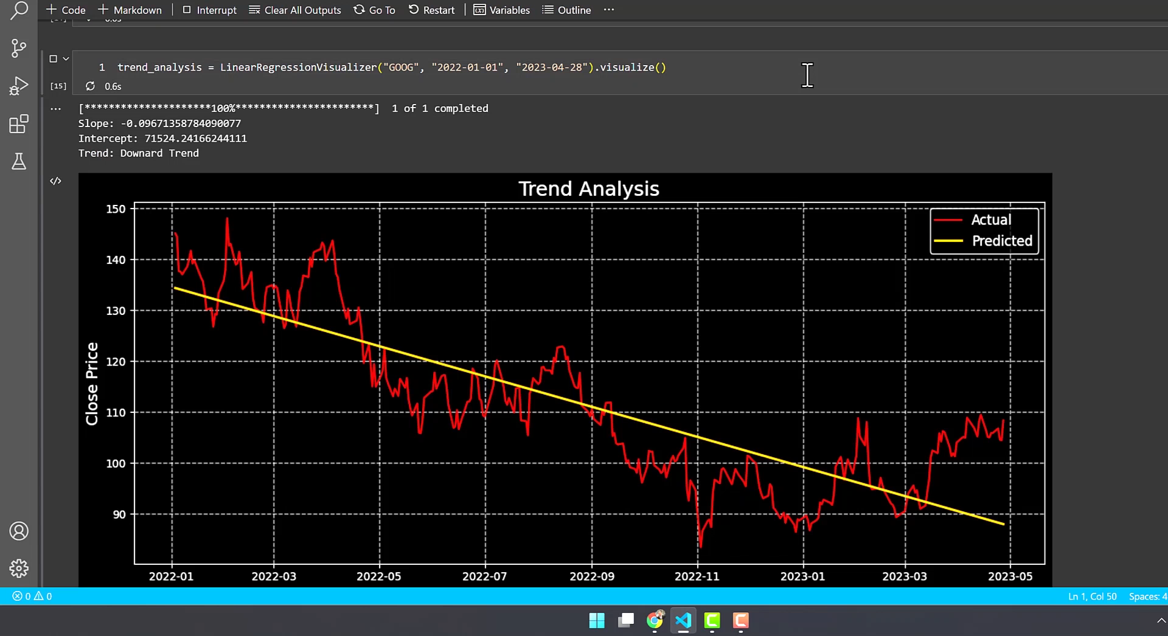
Voice –Enabled Smart WEALTH.
By Hemant Thapa Kiran Babu Basnet

Slide 2


Background
Roughly 33% of world’s adults are financially literate.
01
02
56% of adults get 5 /7
49% of adults get 6/9
42.5% of adults get 3/5
03
04
What you Think?

Slide 3
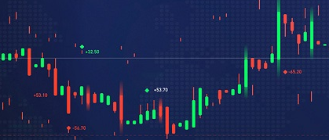
Lack of knowledge
Access to financial services
Motivation
Financial stakeholders be provided with quantitative estimates and feature categories on AI tools, Voice enabled.
Evaluate the statistical dependency of AI features.
Know about financial Technology is not easy.
Multiple considerable factor.
Problem
01
02
03
04
05

Slide 4
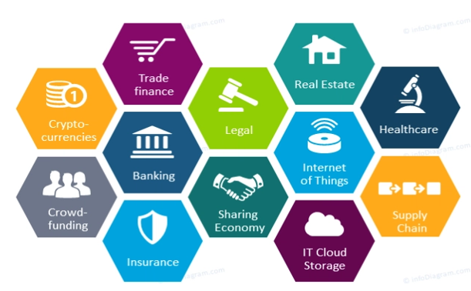

Final Idea
Result, Interpretation Come up with Voice.
Figure out the world’s leading , future world and to visualize, and come up with voice output.
Built a reasonable analytic based on time series analysis for forecasting the price of commodities.
01
02
03
04
05

Slide 5

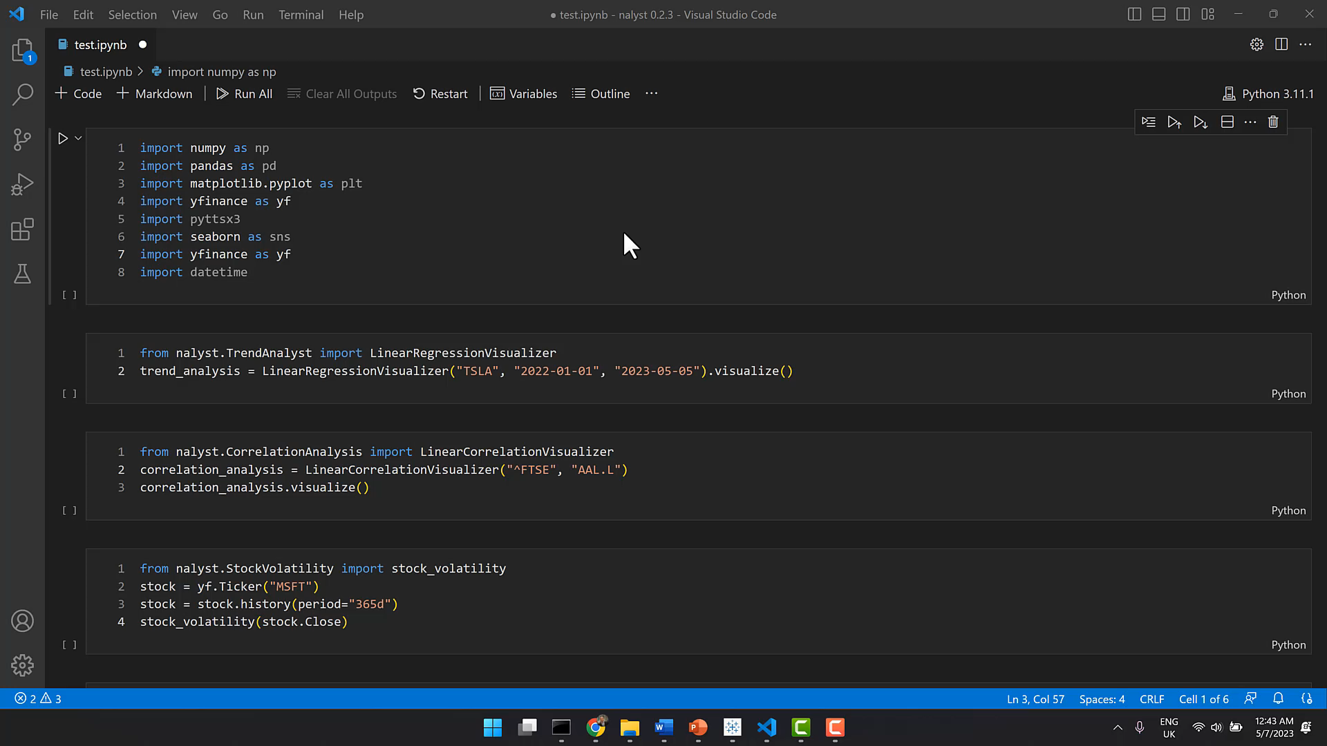

Slide 6
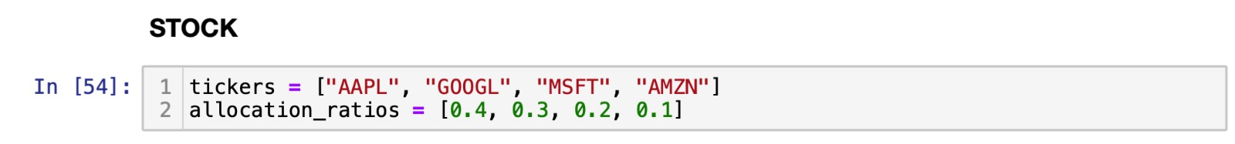
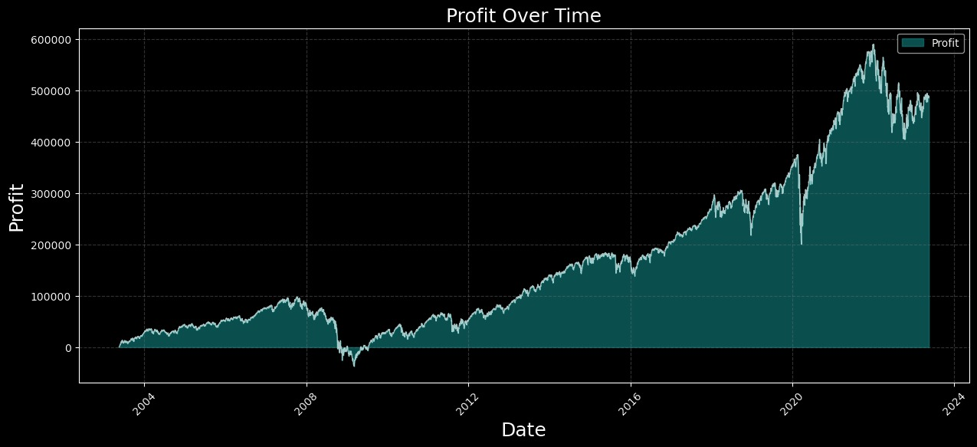

01
02
03
04
05

Slide 7
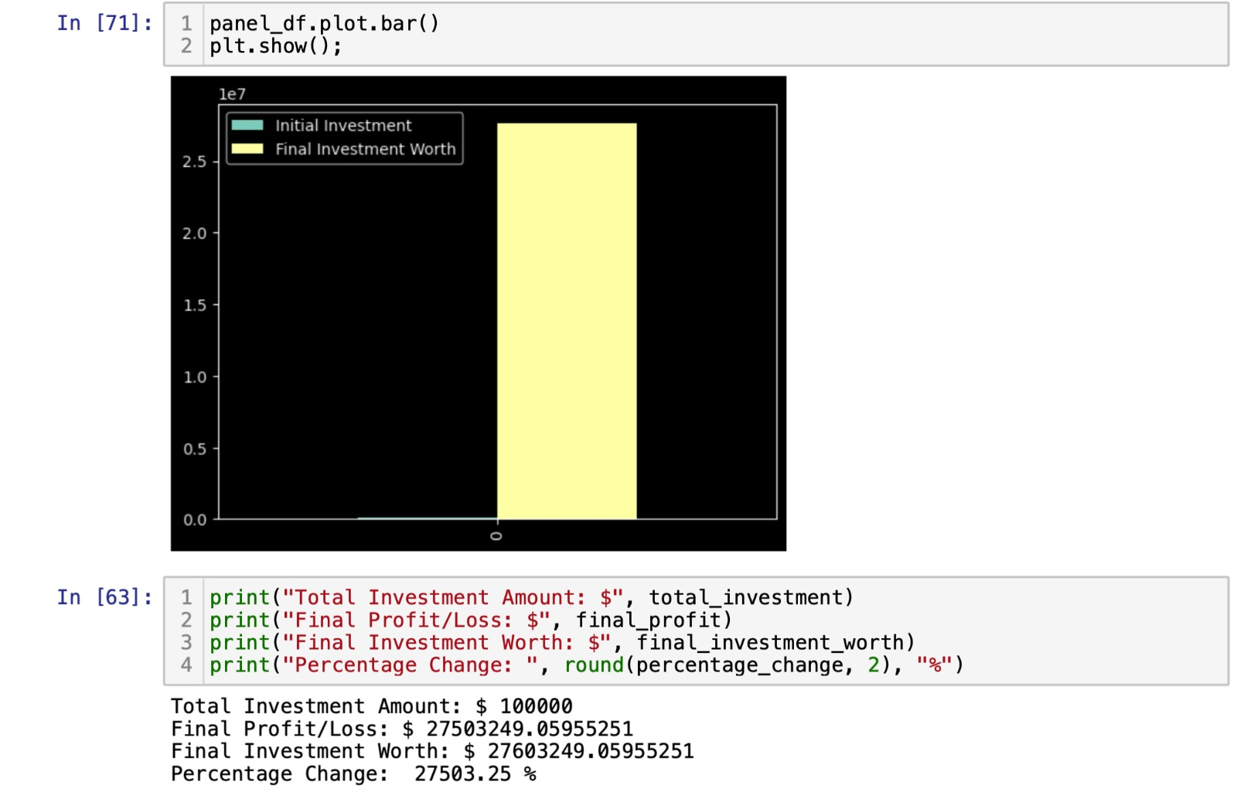

Slide 8

E
Working
1. Understanding Financial Market - scenario
2.EDA(Exploratory Data Analysis) –Quantitave
3.ML(Machine Learning)-Qualitative
4. Recommendation
5. Decision making
01
02
03
04
05
06

Slide 9



Future Development Plan
Possible ML Solution Future Availability
Future Improvement
Data set optimization
Advanced feature selection
Involve economic prospects.
Sentiment analysis
Demand Supply Analysis.

Slide 10


